Slide 1
DOTNET Basics

Slide 2

What is Framework ?
A framework is a set of tools in programming on which to build well-structured, reliable software and systems.

Slide 3
.NET Framework
.NET is a framework to develop software applications.
It is designed and developed by Microsoft in 2000.
It is used to develop applications for Web, Windows and Phone.
It provides various functionalities and support.

Slide 4
Consists of two main parts :
- Common Language Runtime (CLR)
- .NET Framework Class Library (FCL)
This framework contains a large number of class libraries known as Framework Class Library (FCL).
The software programs written in .NET are executed in the execution environment, which is called CLR (Common Language Runtime).

Slide 5
Common Language Runtime (CLR)
It is a program execution engine that loads and executes the program.
It acts as an interface between the framework and operating system.
It does exception handling, memory management, and garbage collection.

Slide 6
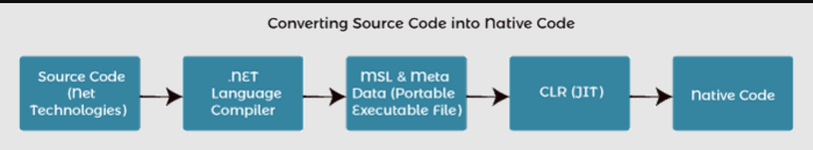
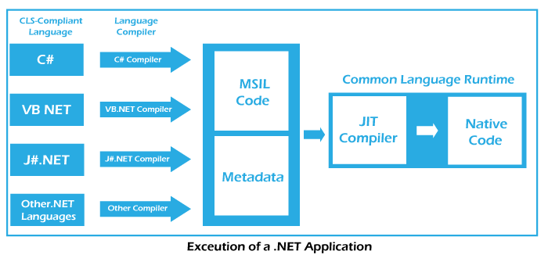

Slide 7
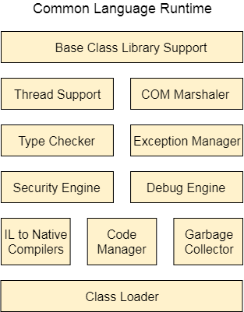
Components of CLR

Slide 8
Base Class Library Support
It is a class library that supports classes for the .NET application.
Thread Support
It manages the parallel execution of the multi-threaded application.
COM Marshaler
It provides communication between the COM objects and the application.
Security Engine
It enforces security restrictions.
Debug Engine
It allows you to debug different kinds of applications.

Slide 9
Type Checker
It checks the types used in the application and verifies that they match the standards provided by the CLR.
Code Manager
It manages code at execution runtime.
Garbage Collector
It releases the unused memory and allocates it to a new application.
Exception Handler
It handles the exception at runtime to avoid application failure.
Class Loader
It is used to load all classes at run time.

